Slide 1



Tennis Central - Dashboard
View in Power BI
Last data refresh:
15-04-2025 20:58:07 UTC
Downloaded at:
24-04-2025 20:41:16 UTC

Slide 2
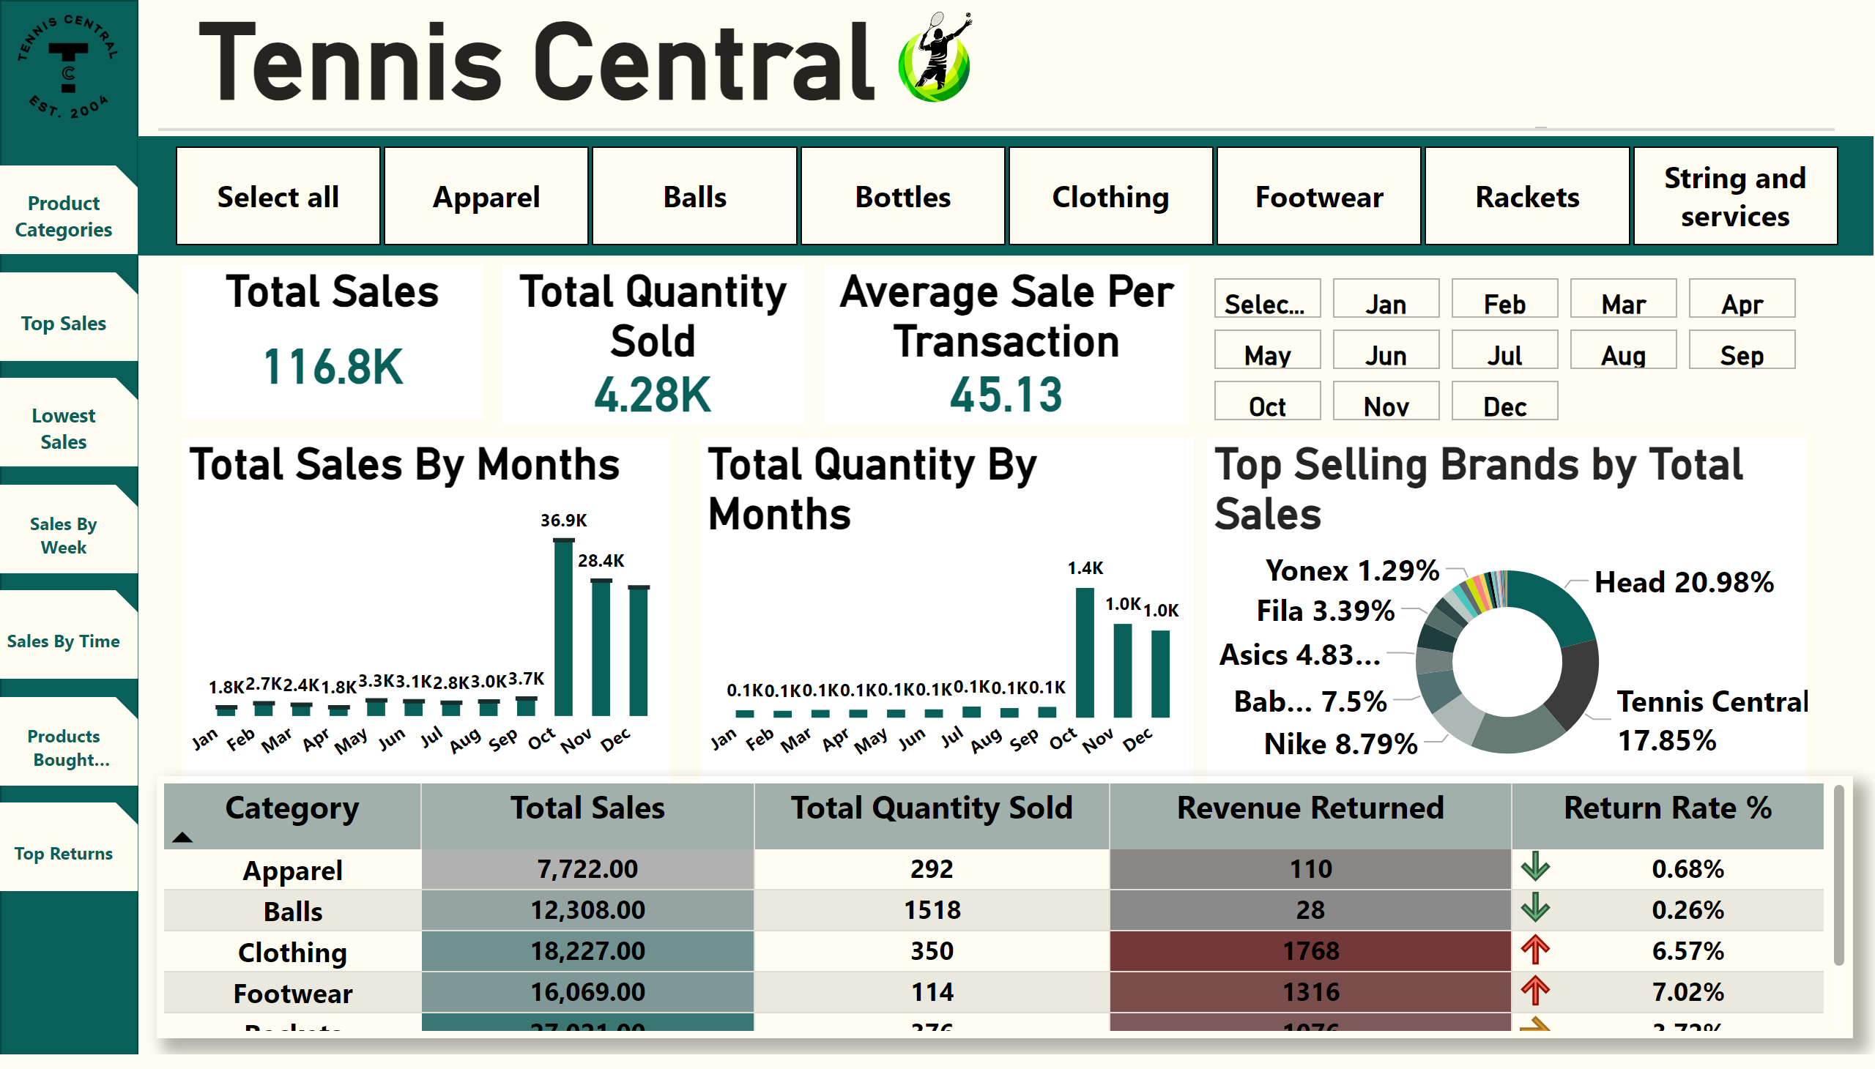
Overview
Notes:
Tennis Central
No alt text provided
shape
No alt text provided
shape
No alt text provided
image
No alt text provided
actionButton
No alt text provided
actionButton
No alt text provided
actionButton
No alt text provided
actionButton
No alt text provided
actionButton
No alt text provided
actionButton
No alt text provided
actionButton
No alt text provided
Total Sales By Months
No alt text provided
Total Quantity By Months
No alt text provided
slicer
No alt text provided
image
No alt text provided
Top Selling Brands by Total Sales
No alt text provided
Total Sales
No alt text provided
Total Quantity Sold
No alt text provided
Average Sale Per Transaction
No alt text provided
Lowest Selling Products by Category
No alt text provided
advancedSlicerVisual
No alt text provided

Slide 3
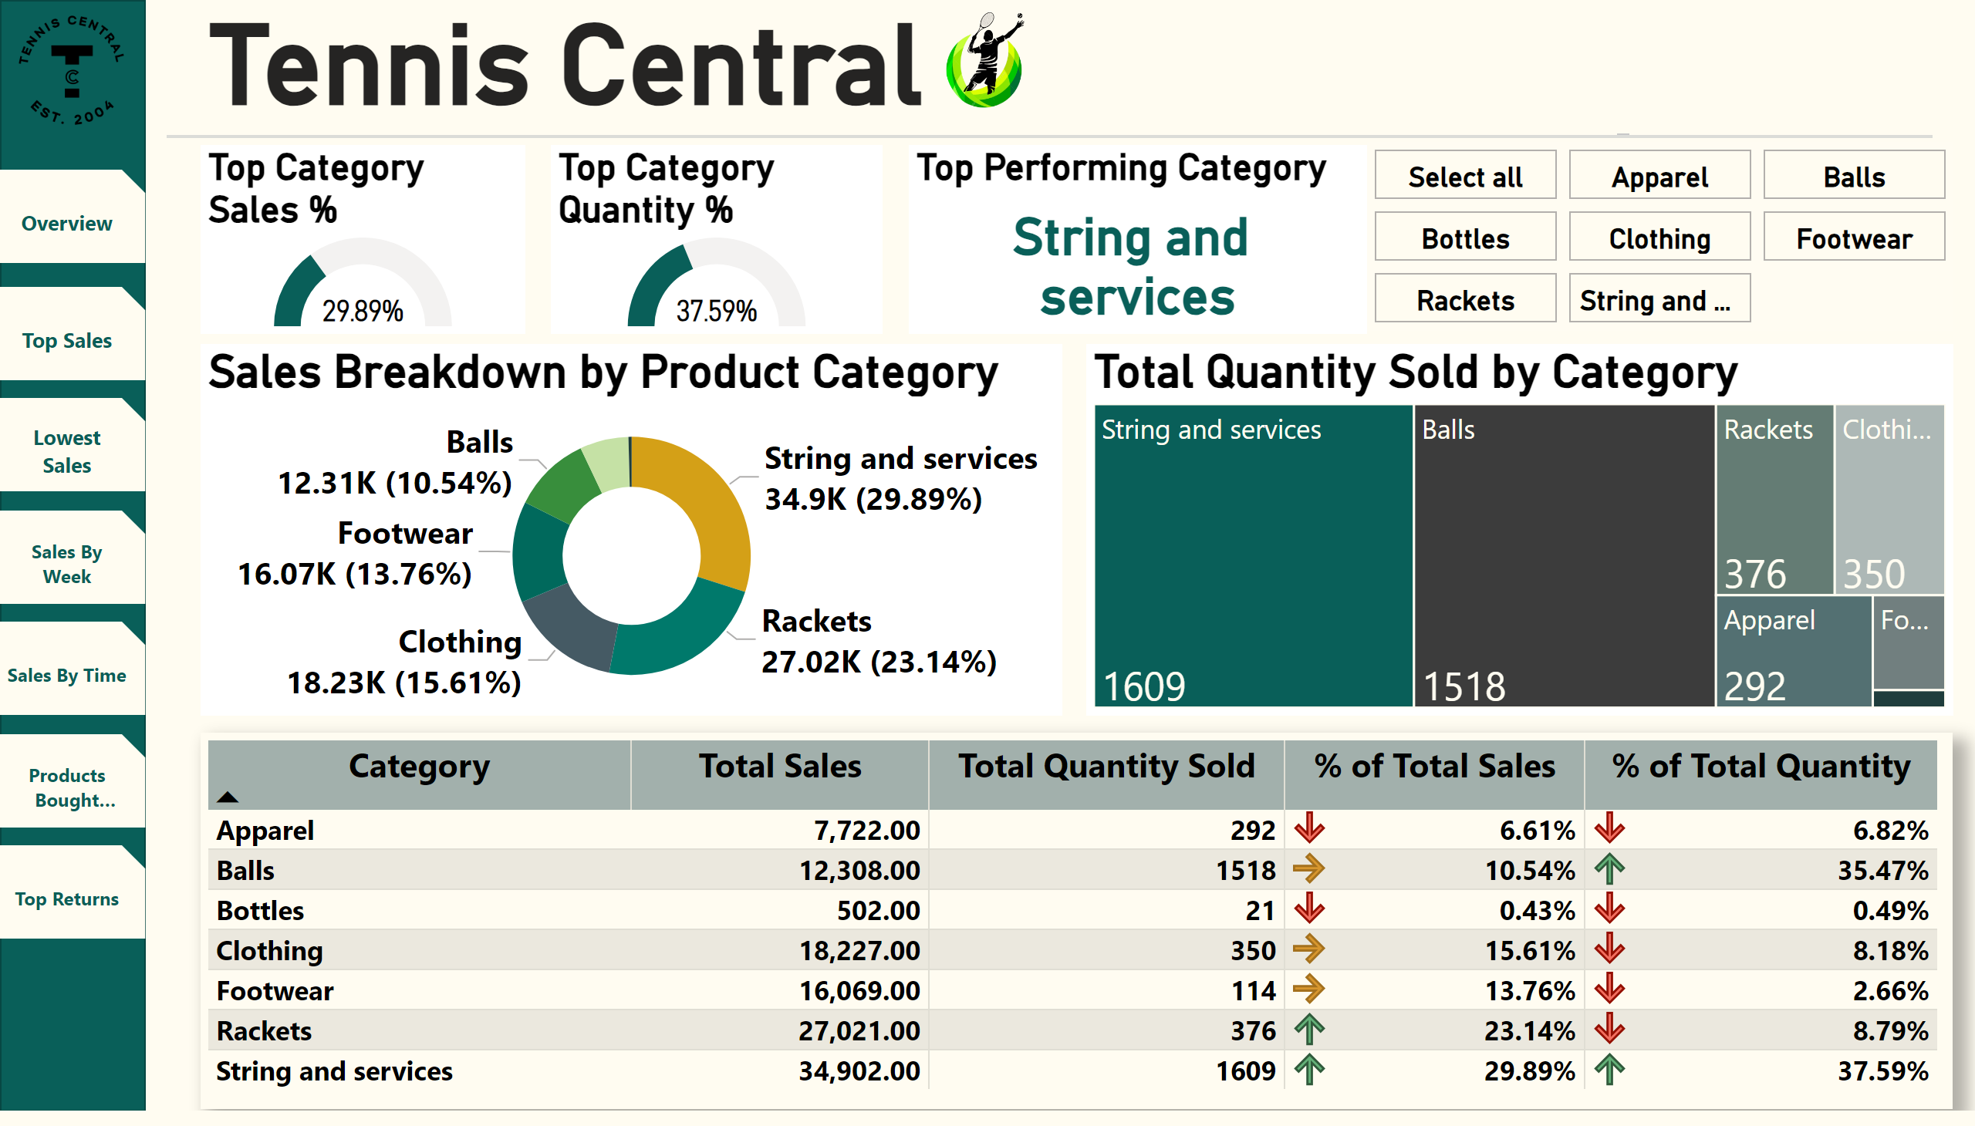
Product Categories
Notes:
Tennis Central
No alt text provided
shape
No alt text provided
shape
No alt text provided
image
No alt text provided
Sales Breakdown by Product Category
No alt text provided
image
No alt text provided
actionButton
No alt text provided
actionButton
No alt text provided
actionButton
No alt text provided
actionButton
No alt text provided
actionButton
No alt text provided
actionButton
No alt text provided
gauge
No alt text provided
Top Performing Category
No alt text provided
advancedSlicerVisual
No alt text provided
treemap
No alt text provided
pivotTable
No alt text provided
gauge
No alt text provided
actionButton
No alt text provided

Slide 4
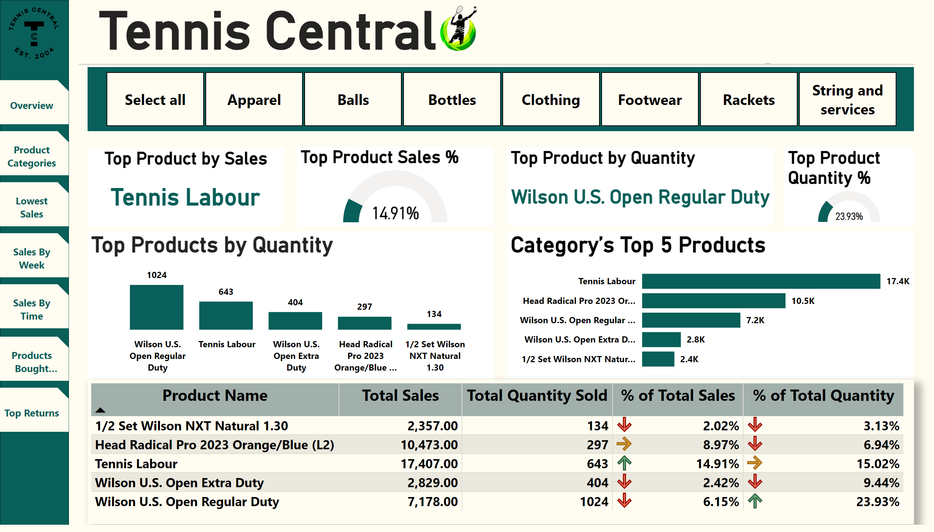
Top Sales
Notes:
Tennis Central
No alt text provided
shape
No alt text provided
shape
No alt text provided
image
No alt text provided
slicer
No alt text provided
image
No alt text provided
actionButton
No alt text provided
actionButton
No alt text provided
actionButton
No alt text provided
actionButton
No alt text provided
actionButton
No alt text provided
actionButton
No alt text provided
actionButton
No alt text provided
Top Product by Sales
No alt text provided
gauge
No alt text provided
gauge
No alt text provided
Category’s Top 5 Products
No alt text provided
Top Product by Quantity
No alt text provided
Category’s Top 5 Products
No alt text provided
Top Products by Quantity
No alt text provided

Slide 5
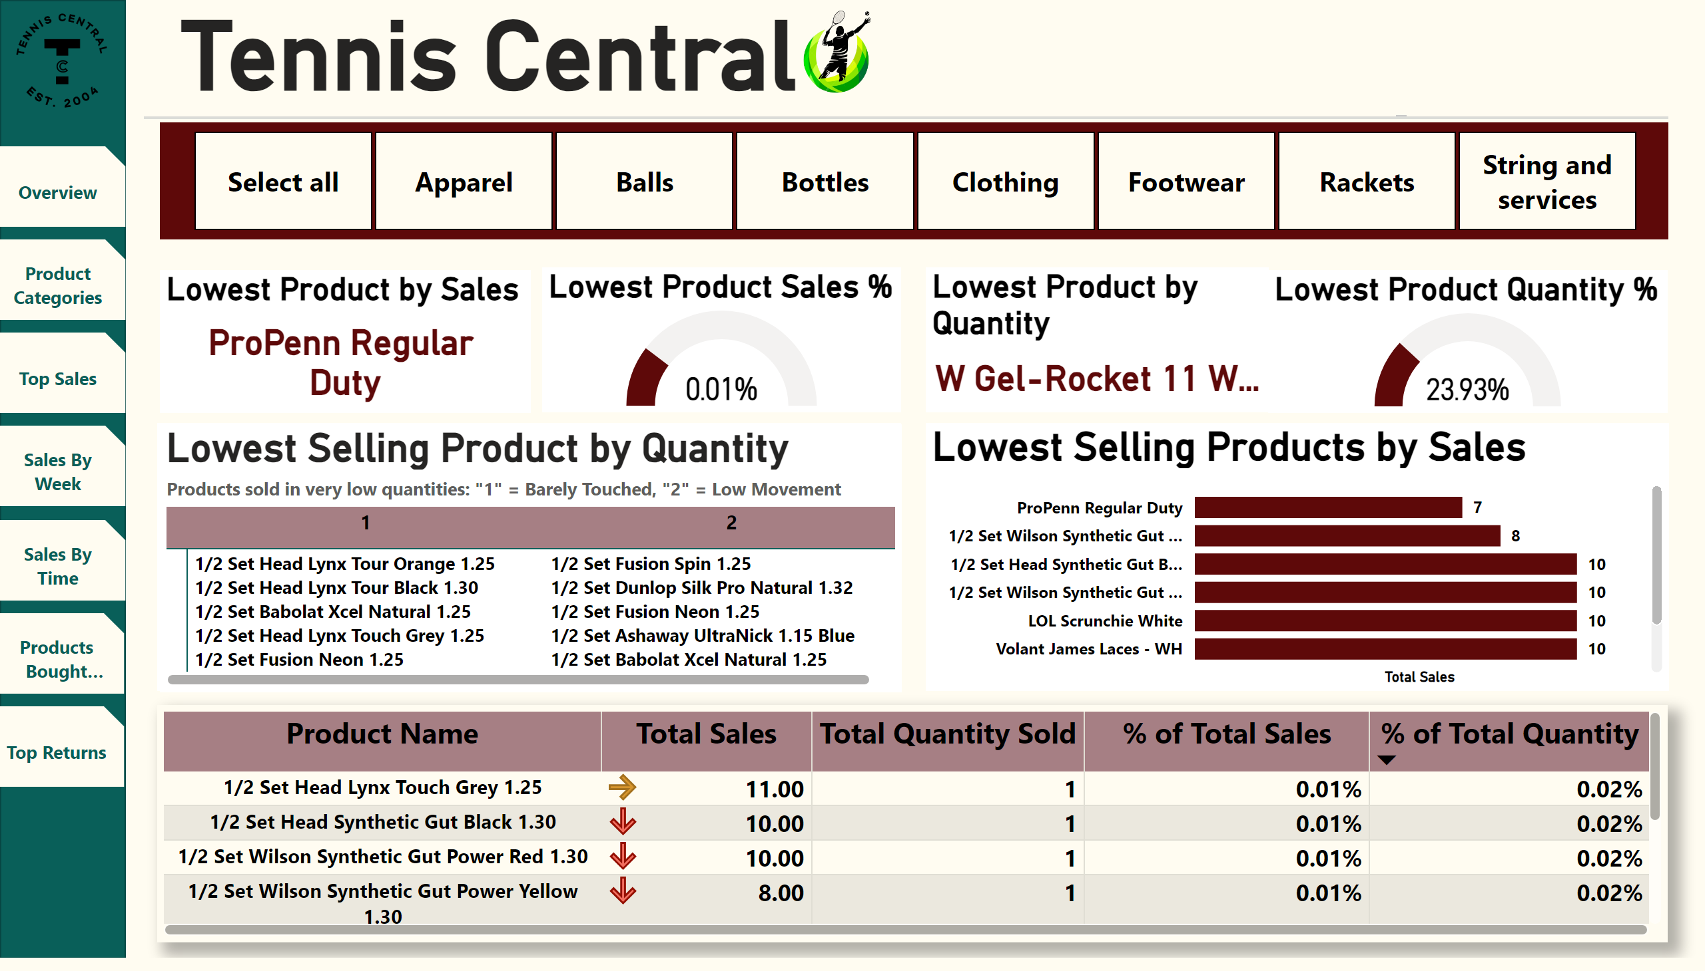
Lowest Sales
Notes:
Tennis Central
No alt text provided
shape
No alt text provided
shape
No alt text provided
image
No alt text provided
image
No alt text provided
actionButton
No alt text provided
actionButton
No alt text provided
actionButton
No alt text provided
actionButton
No alt text provided
actionButton
No alt text provided
actionButton
No alt text provided
actionButton
No alt text provided
slicer
No alt text provided
Lowest Product by Sales
No alt text provided
Lowest Product Quantity %
No alt text provided
Lowest Product by Quantity
No alt text provided
Lowest Selling Products by Sales
No alt text provided
Lowest Product Sales %
No alt text provided
Lowest Selling Products by Quantity
No alt text provided
Lowest Selling Products by Category
No alt text provided
Lowest Selling Product by Quantity
No alt text provided

Slide 6
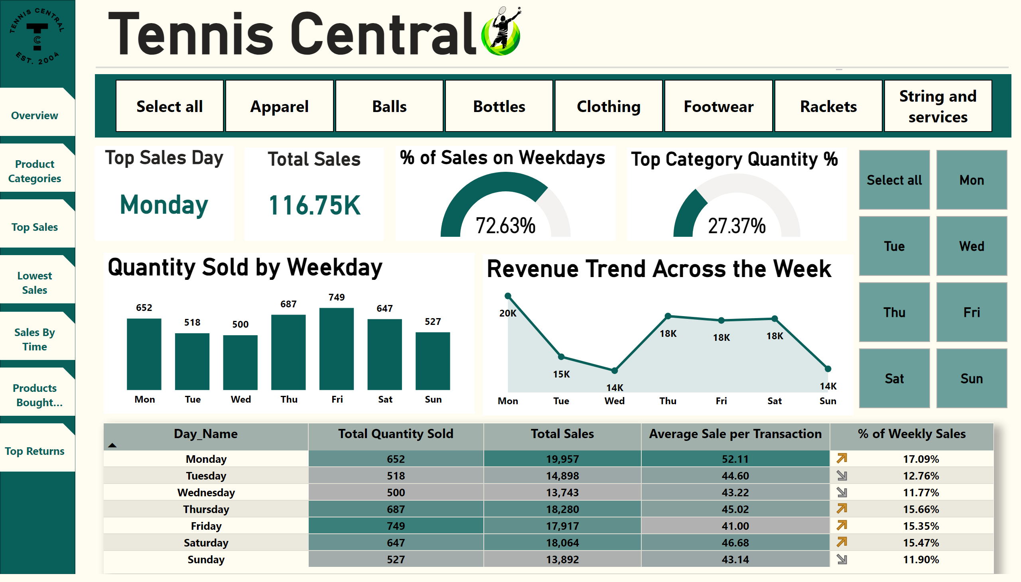
Sales By Week
Notes:
Top Category Quantity %
No alt text provided
advancedSlicerVisual
No alt text provided
Revenue Trend Across the Week
No alt text provided
pivotTable
No alt text provided
% of Sales on Weekdays
No alt text provided
Total Sales
No alt text provided
Top Sales Day
No alt text provided
slicer
No alt text provided
actionButton
No alt text provided
actionButton
No alt text provided
actionButton
No alt text provided
actionButton
No alt text provided
actionButton
No alt text provided
actionButton
No alt text provided
actionButton
No alt text provided
image
No alt text provided
Quantity Sold by Weekday
No alt text provided
image
No alt text provided
shape
No alt text provided
shape
No alt text provided
Tennis Central
No alt text provided

Slide 7
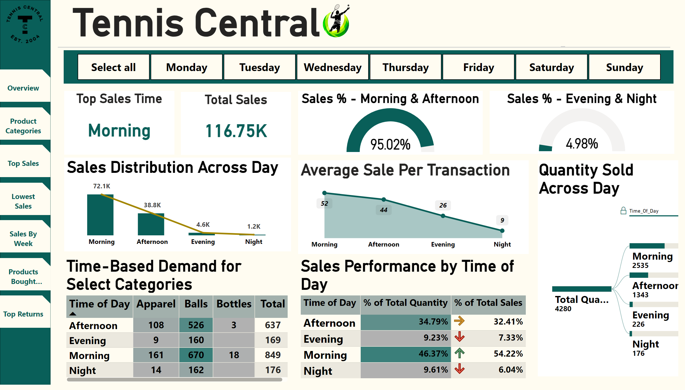
Sales By Time
Notes:
Tennis Central
No alt text provided
shape
No alt text provided
shape
No alt text provided
image
No alt text provided
Sales Distribution Across Day
No alt text provided
image
No alt text provided
actionButton
No alt text provided
actionButton
No alt text provided
actionButton
No alt text provided
actionButton
No alt text provided
actionButton
No alt text provided
actionButton
No alt text provided
actionButton
No alt text provided
Top Sales Time
No alt text provided
Total Sales
No alt text provided
Sales % - Morning & Afternoon
No alt text provided
Sales % - Evening & Night
No alt text provided
slicer
No alt text provided
Average Sale Per Transaction
No alt text provided
Quantity Sold Across Day
No alt text provided
Time-Based Demand for Select Categories
No alt text provided
Sales Performance by Time of Day
No alt text provided

Slide 8
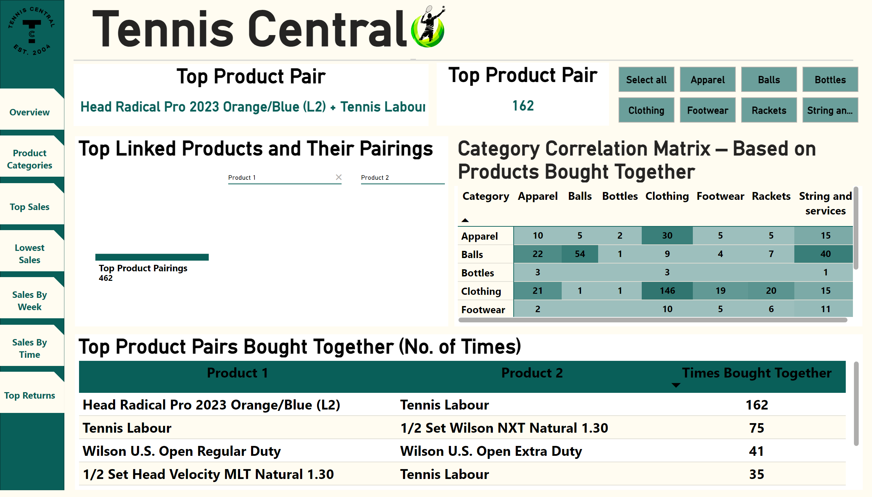
Products Bought Togather
Notes:
Tennis Central
No alt text provided
shape
No alt text provided
shape
No alt text provided
image
No alt text provided
Top Product Pairs Bought Together (No. of Times)
No alt text provided
image
No alt text provided
actionButton
No alt text provided
actionButton
No alt text provided
actionButton
No alt text provided
actionButton
No alt text provided
actionButton
No alt text provided
actionButton
No alt text provided
actionButton
No alt text provided
Top Linked Products and Their Pairings
No alt text provided
Top Product Pair
No alt text provided
Top Product Pair
No alt text provided
advancedSlicerVisual
No alt text provided
Category Correlation Matrix – Based on Products Bought Together
No alt text provided

Slide 9
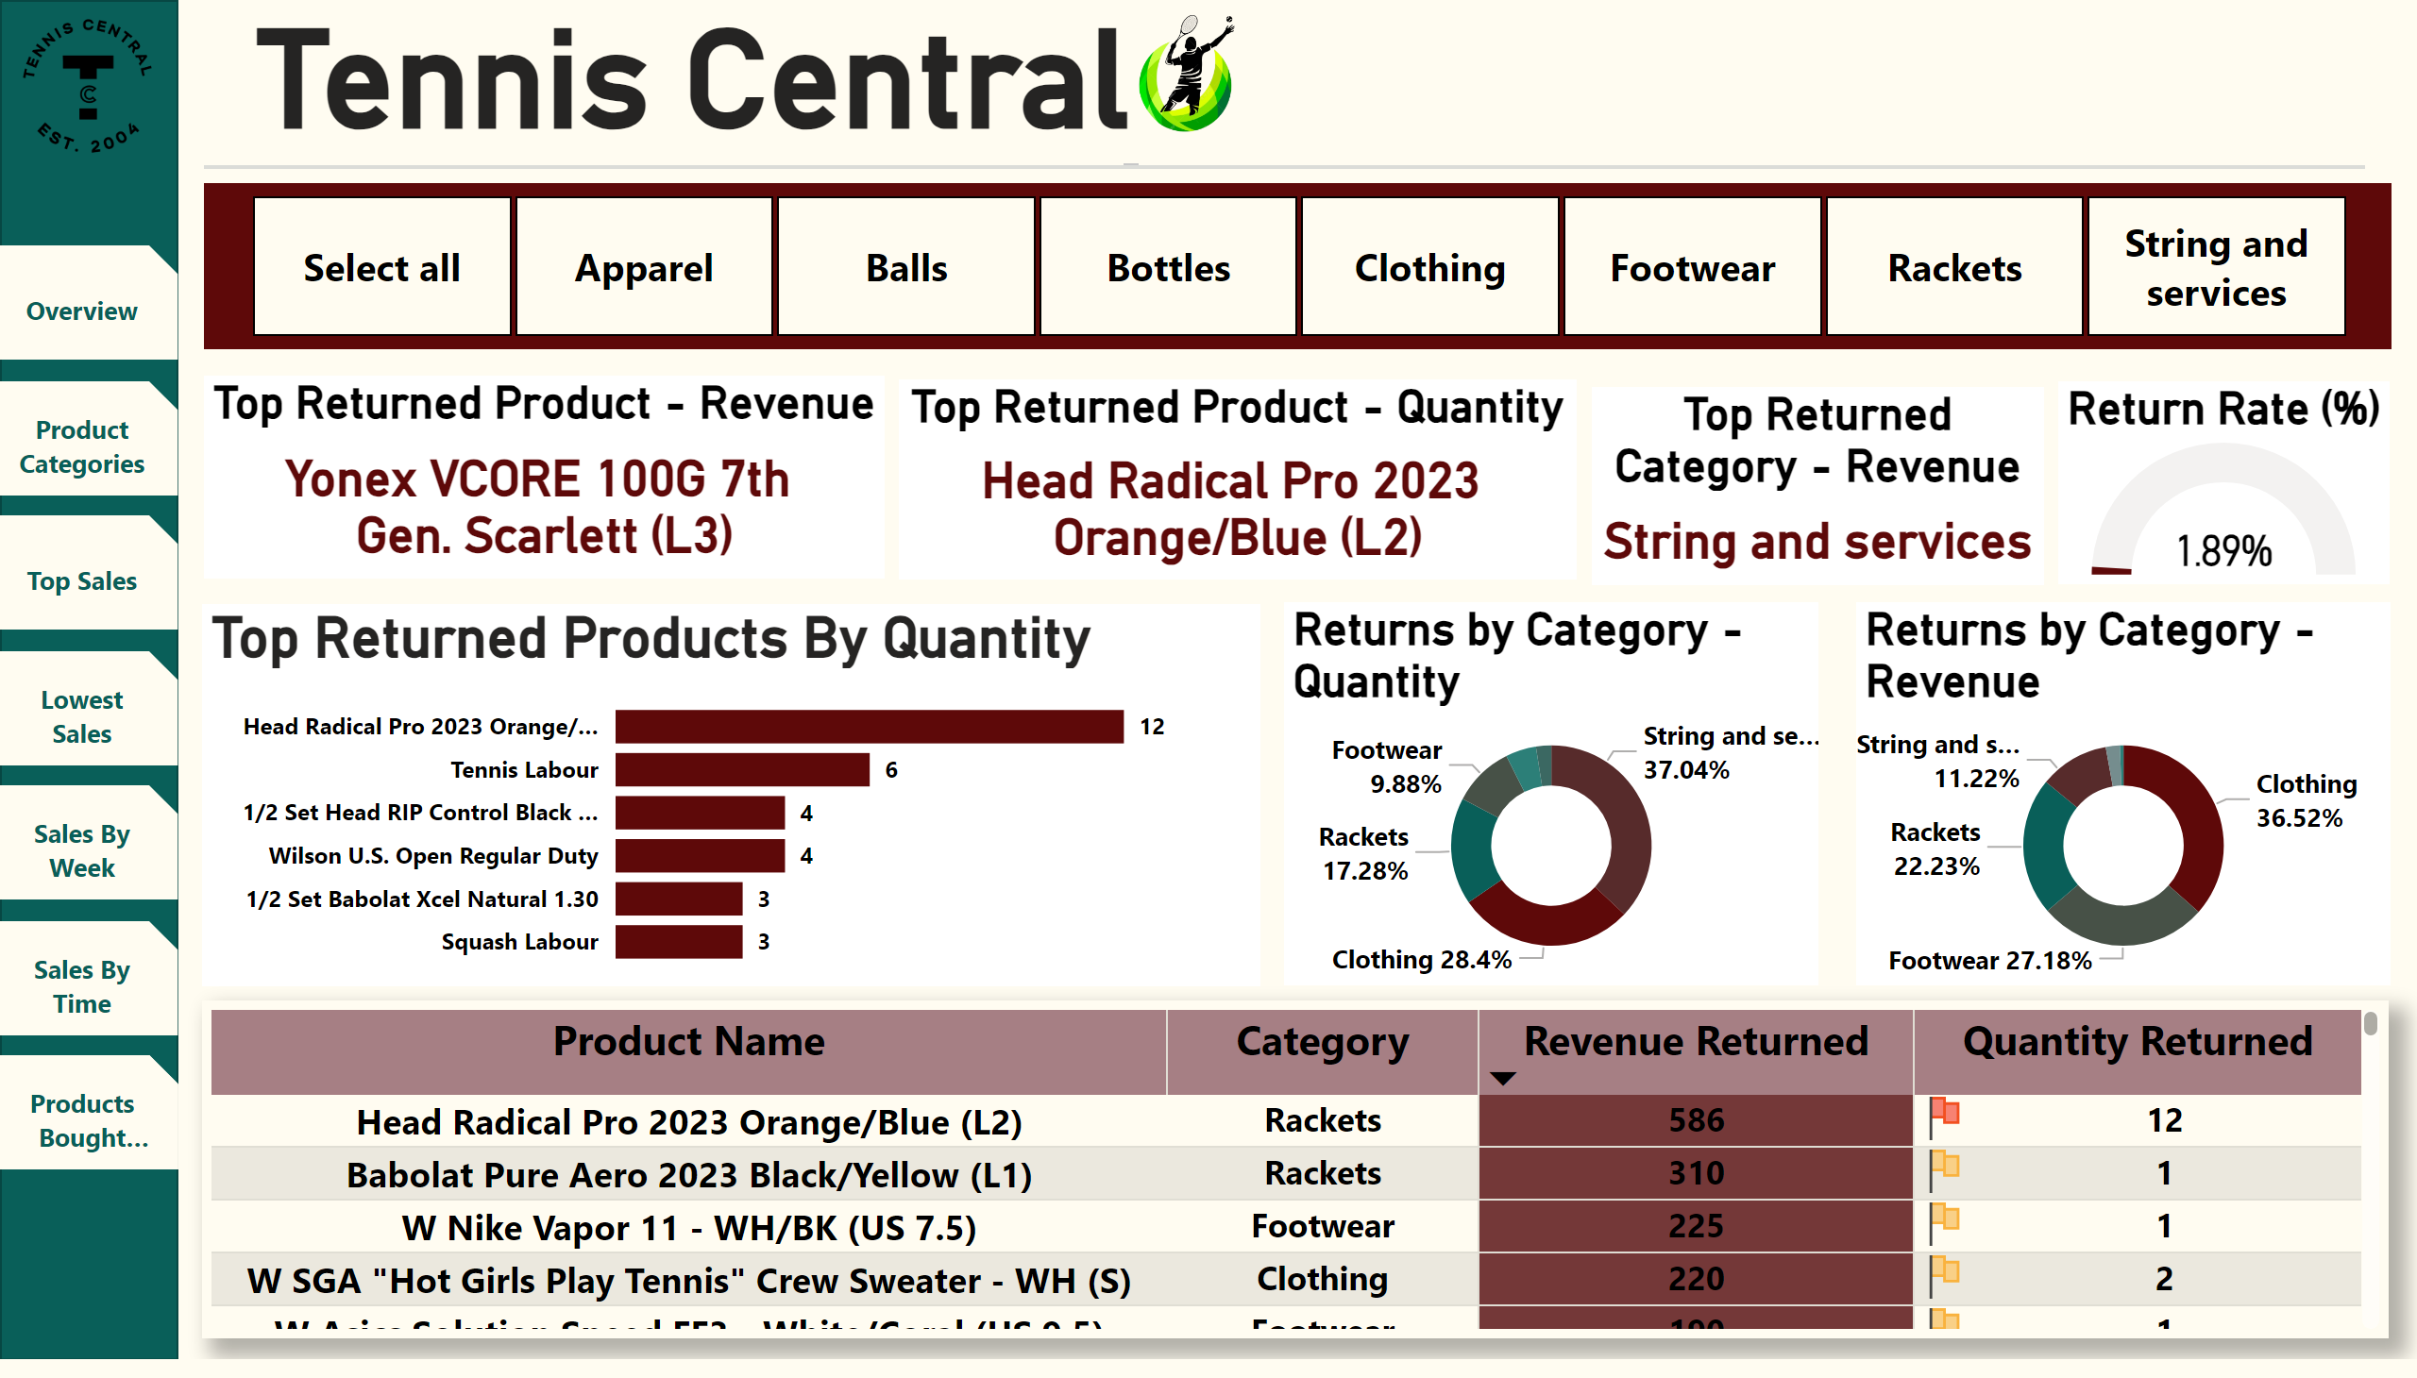
Top Product Returns
Notes:
Tennis Central
No alt text provided
shape
No alt text provided
shape
No alt text provided
image
No alt text provided
image
No alt text provided
actionButton
No alt text provided
actionButton
No alt text provided
actionButton
No alt text provided
actionButton
No alt text provided
actionButton
No alt text provided
actionButton
No alt text provided
actionButton
No alt text provided
Return Rate (%)
No alt text provided
Top Returned Category - Revenue
No alt text provided
Top Returned Product - Quantity
No alt text provided
Top Returned Product - Revenue
No alt text provided
slicer
No alt text provided
Lowest Selling Products by Category
No alt text provided
Top Returned Products By Quantity
No alt text provided
Returns by Category - Quantity
No alt text provided
Returns by Category - Revenue
No alt text provided

